Slide 1
Drivers and basic modeling of Natural Gas Prices In The United States
Group Members:
Wilson Aliaga
Carlton Lewis
Velmarini Vasquez

Slide 2
Project Questions
Supply Drivers questions
How does production vary over time around the country?
How do natural gas imports and storage contribute to the supply over time?
Demand questions
How does natural gas consumption evolve in US?
How do natural gas exports change over time?
How does seasonal effects affect gas demand?
How does economic growth influence gas consumption?
Price questions
How does natural gas price relate to demand and supply drivers?

Slide 3
Data Set Sources
U.S. Energy Information Administration (EIA)
World Weather
Federal Reserve Economic Data (FRED)
US Census Database

Slide 4
DatA ExploratioN
Data
Sources | Extraction | Cleaning | Type | Quantity | Analysis Methods
EIA | API Key JSON Excel Files | Conversion into, into pandas dataframes lists or dictionaries for data manipulation. Excel files conversion into pandas dataframes | Natural gas : Production Consumption Storage Prices | 7262 series 20 Excel spreadsheets conversion into pandas data frame for data manipulation. | Descriptive statistics Time series Regression Analysis Matrix analysis
World Weather | API Key | Conversion into dictionary for data manipulation | Historical temperature changes | 1 series | Time series
Google Maps Platform | API Key | Conversion into, into pandas dataframes lists or dictionaries for data manipulation. | USA Map | JSON file to explore 3221 counties delimitations | Production changes per county over time.
FRED | CSV file | Conversion into pandas dataframe | CPI extraction | 1 CSV | Conversion of US $ to 2018 value
Census | API Key | Conversion into pandas dataframe | Testing Map | 1 series | Superimposed on Google map to determine county per state

Slide 5
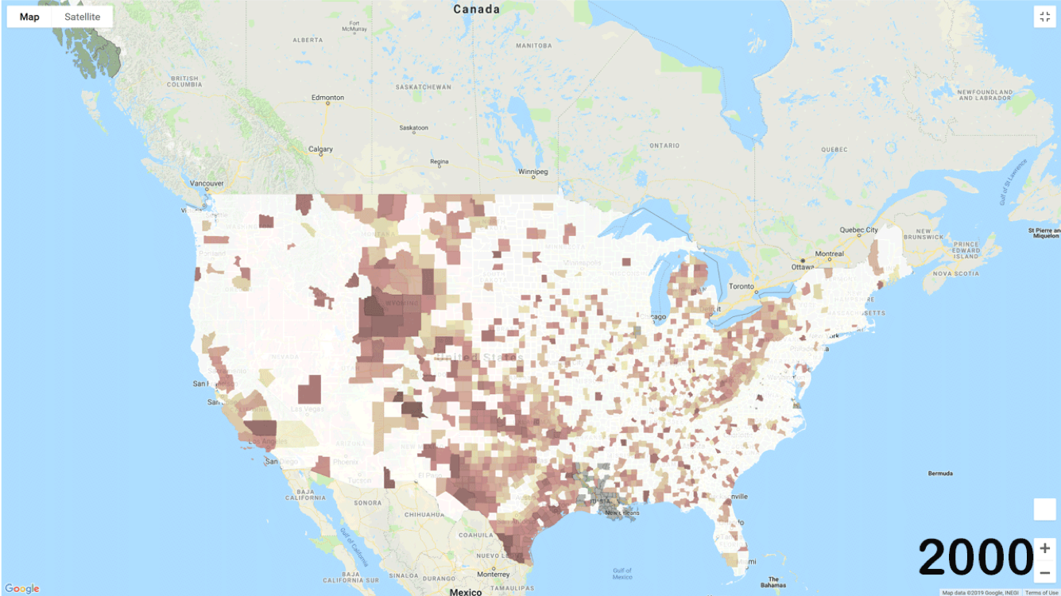
U.S. GaS Production

Slide 6
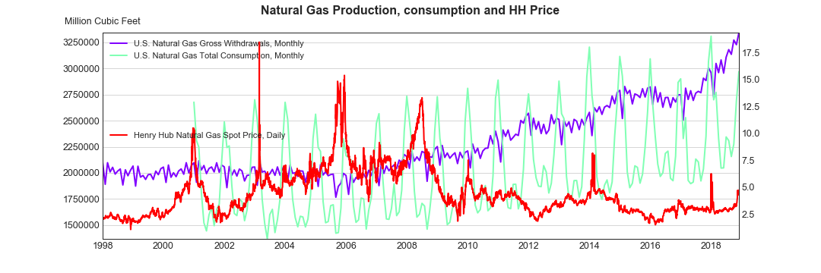
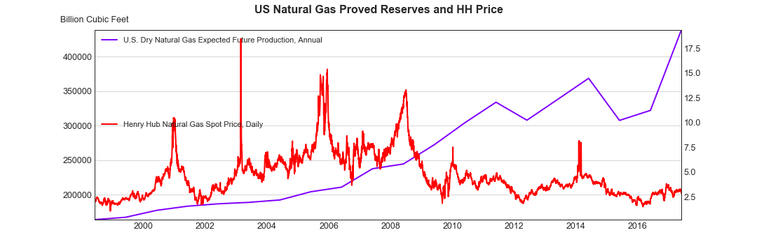

Slide 7
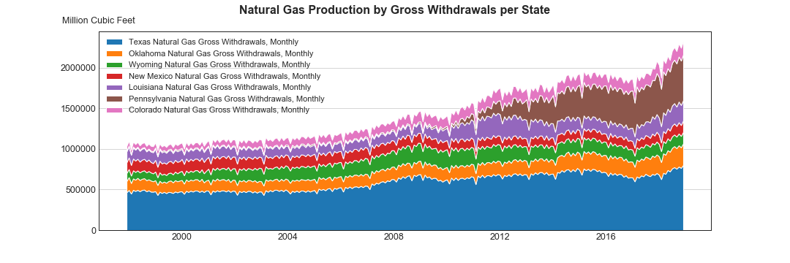
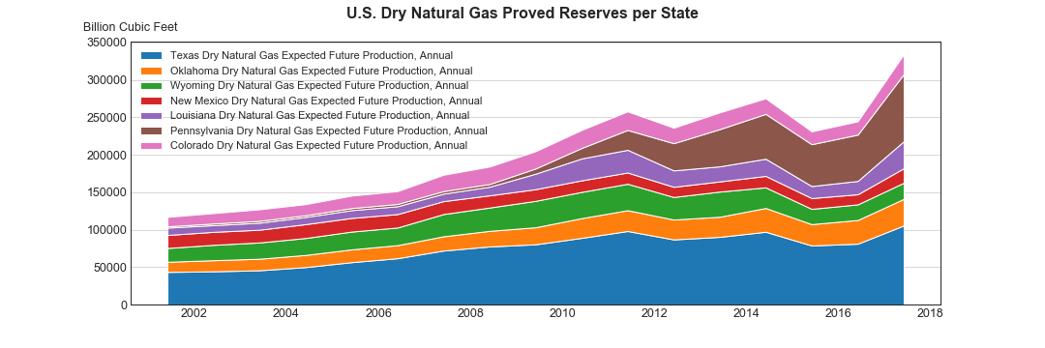

Slide 8
Analysis Process
How price and economic drivers correlate with each other.
Series decomposition
Time Series Models
Random Walk
Moving Average (MA)
Autoregressive (AR)
ARIMA

Slide 9
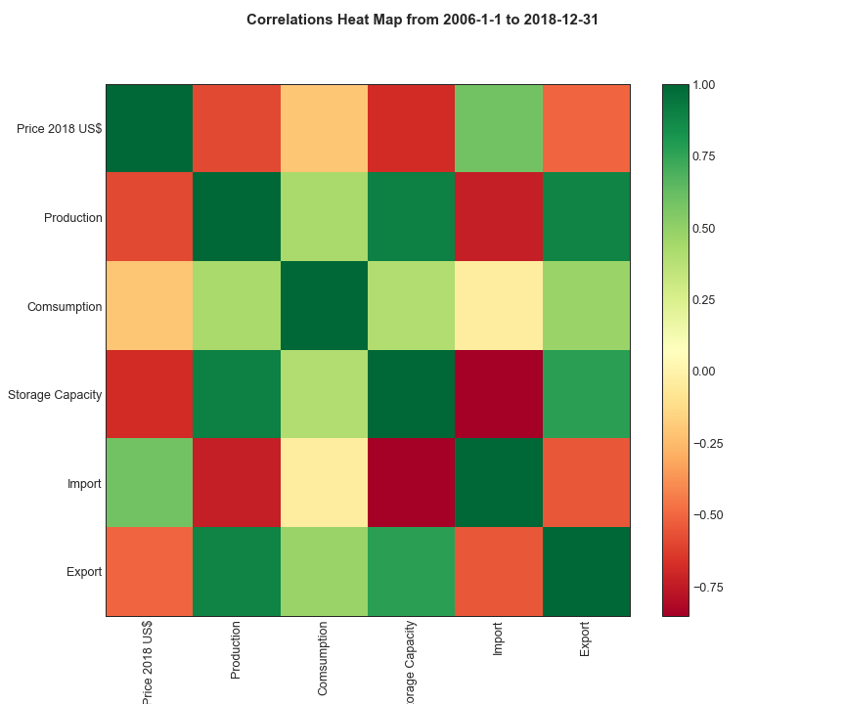
How does HH price correlate with supply and demand variables?

Slide 10
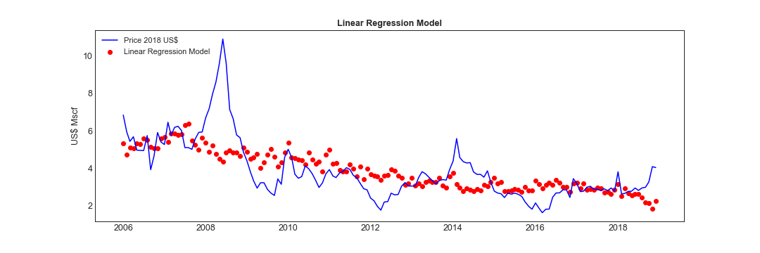
Hypothesis Test
Variable | R² | p
Production | 0.78 | 1.82e-53
Consumption | 0.79 | 5.72e-55
Storage Capacity | 0.83 | 5.36e-62
Import | 0.90 | 3.01e-80
Export | 0.54 | 8.07e-28
How about time effects (lags, cycles, shocks, etc)?

Slide 11
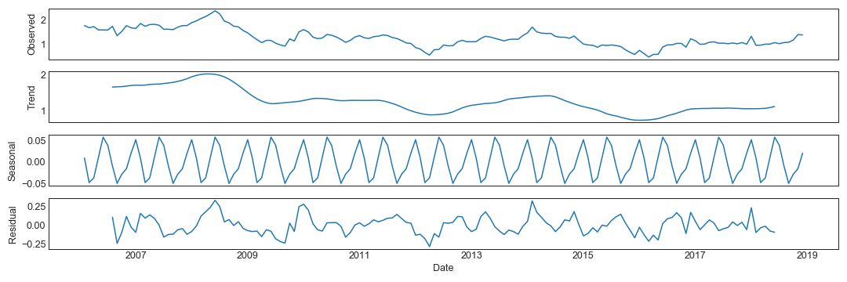
Decomposing Natural Gas Prices

Slide 12
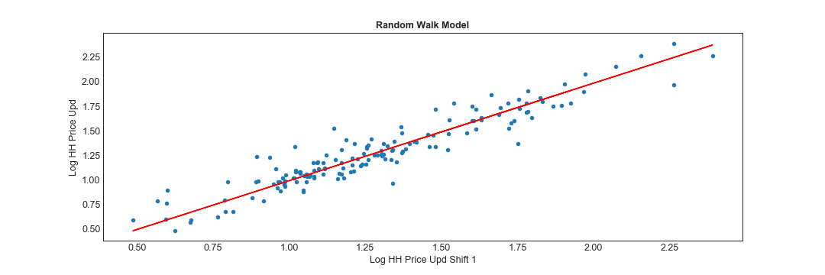
Y_{t} = Log(P_{t}) : reduce variability
Is there a relation between Y_{t} and Y_{t-1} ?
Null Hypothesis: No relation between Y_{t} and Y_{t-1}
Variable | R² | p
Y_{t-1} | 0.99 | 1.25e-161
Therefore, the best estimate for tomorrow’s price is today’s price

Slide 13


Random Walk :
$$Y_{t}=Y_{t−1}+ε$$
Moving Average Model (MA) :
$$Y_{t}=μ+ {r_{1}ε}_{t−1}+r_{2}ε_{t−2}+…+r_{q}ε_{t−q}$$
Auto Regressive Model (AR) :
$$Y_{t}={w_{1}Y}_{t−1}+w_{2}Y_{t−2}+…+w_{p}Y_{t−p}+ε$$
Auto Regressive Integrated Moving Average (ARIMA) :
$$Y_{t}={w_{1}Y}_{t−1}+w_{2}Y_{t−2}+…+w_{n}Y_{t−p}+{r_{1}ε}_{t−1}+r_{2}ε_{t−2}+…+r_{q}ε_{t−q}$$

Slide 14
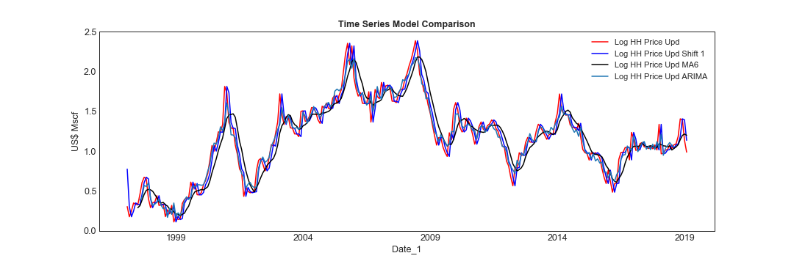

Slide 15
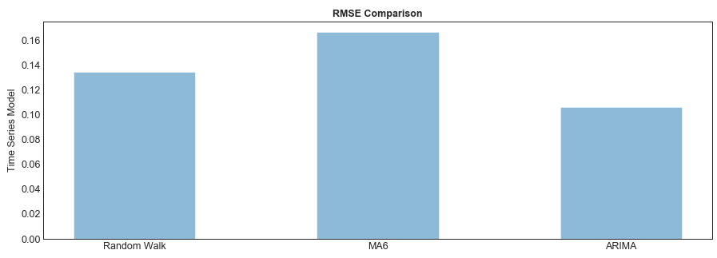
conclusions
ARIMA provides the lowest RMSE since it handles the 3 main components of the series: trend, seasonality and residual
Large investment to materialize changes in the demand explains low R² for exports
Variable | R² | p
Production | 0.78 | 1.82e-53
Consumption | 0.79 | 5.72e-55
Storage Capacity | 0.83 | 5.36e-62
Import | 0.90 | 3.01e-80
Export | 0.54 | 8.07e-28

Slide 16
Despite low prices, proved reserves has been increasing because of extensions and discoveries.

Slide 17
implications of the findings
Despite good fit, time series contains limited past information; therefore, they will be suitable for short term predictions
For long-term predictions, economic drivers should be considered in the model

